Slide 1

Capstone Project - 1
Team 5 :
BOOK RECOMMENDATION SYSTEM
Team Members
RATAN YADAV
RITESH KHATUA
AKSHAY VITHAL YADAV
Dr. SHARATH B R
KRISHNA PAVAN KUMAR KATIPERI
RASHMI R B
RUCHIKA PRAKASH PETKAR
MENTORS
MR. ADVAITH SIR
MISS RAMYA MA’AM

Slide 2
Content
Problem statement
Data Summary
Analysis of different datasets
Data Cleaning
Outlier treatment
Imputing missing values
Different Recommendation Model
Challenges
Conclusion
Future Scope

Slide 3

Problem Statement
During the last few decades,
with the rise of Youtube, Amazon, Netflix, and many other such web services, recommender systems have become much more important in our lives in terms of providing highly personalized and
relevant content.
The main objective is to create a recommendation system to recommend relevant books to users based on popularity and user interests.

Slide 4
Data Summary
The dataset is comprised of three csv files :- Users, Books, Ratings
Users_dataset.
User-ID (unique for each user)
Location (contains city, state and country separated by commas)
Age Shape of Dataset - (278858, 3)
Books_dataset.
ISBN (unique for each book)
Book-Title
Book-Author
Year-Of-Publication
Publisher
Image-URL-S
Image-URL-M
Image-URL-L
Shape of Dataset - (271360, 8)
Ratings_dataset.
User-ID
ISBN
Book-Rating
Shape of Dataset –
(1149780, 3)

Slide 5
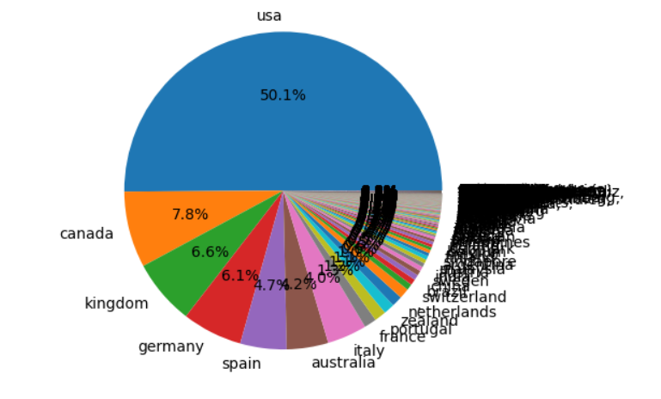
Analysis of different datasets
Observations from Users (Location)
Splitting Location column and analysing country.
Most active readers are from USA.

Slide 6
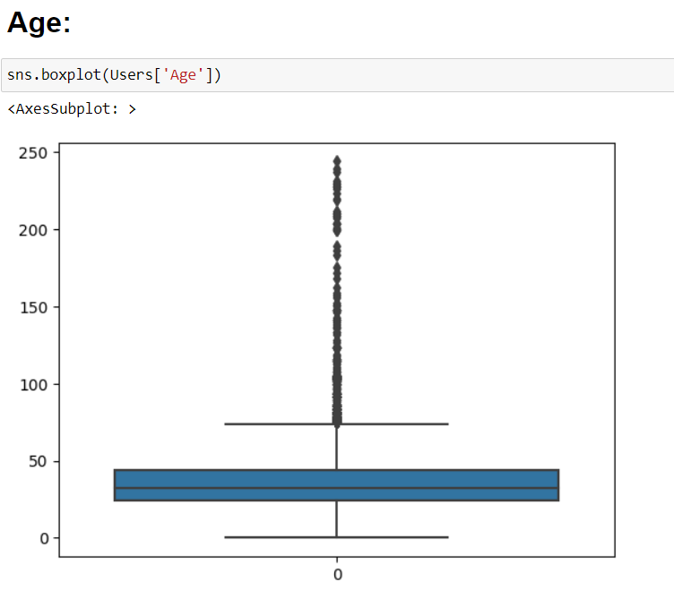
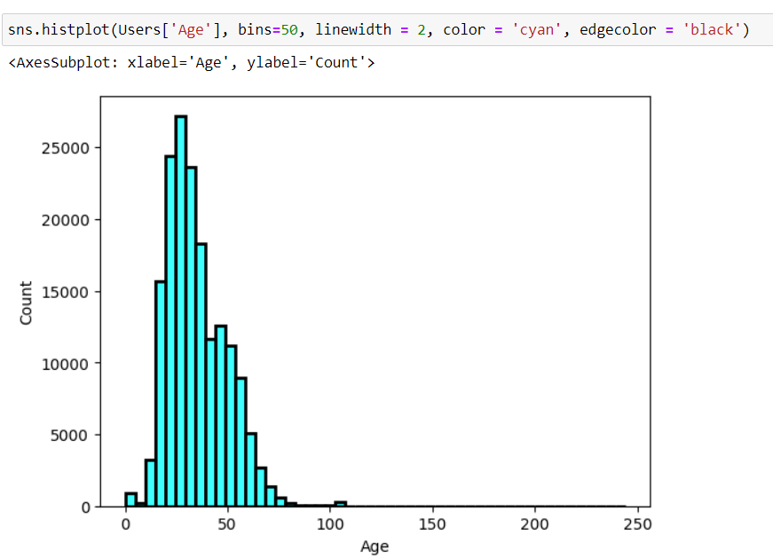
Observations from Users (age)
Analyzing the age from users dataset.
And we have many outliers having age value
more than 100.

Slide 7
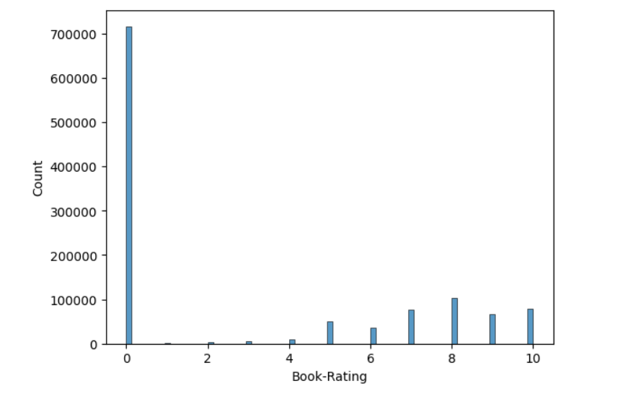
Observations from Ratings (Books_Rating)
Higher ratings are more common amongst users
Rating 0 has been rated the highest number of times

Slide 8
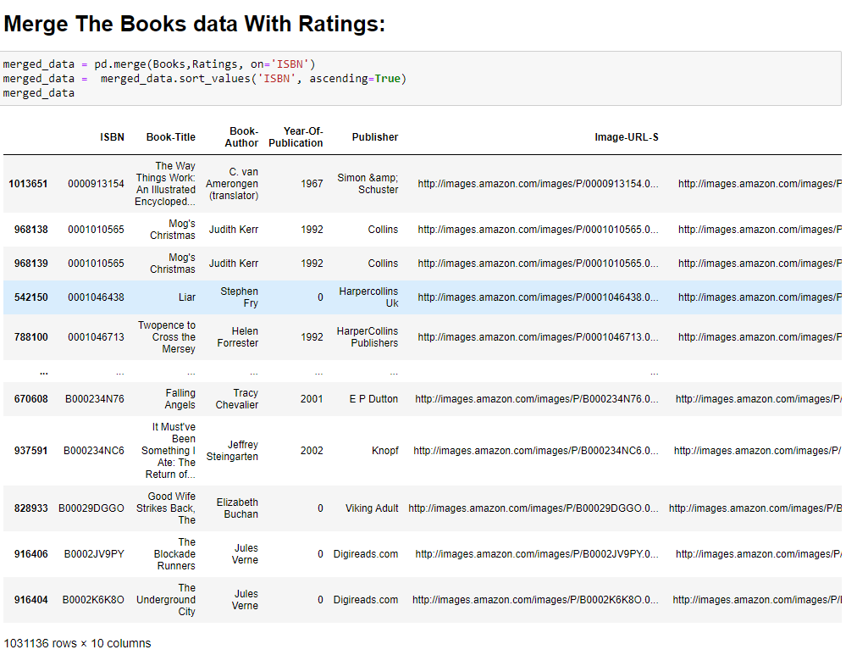
Observations from merge dataset
(Books and RatingS)

Slide 9
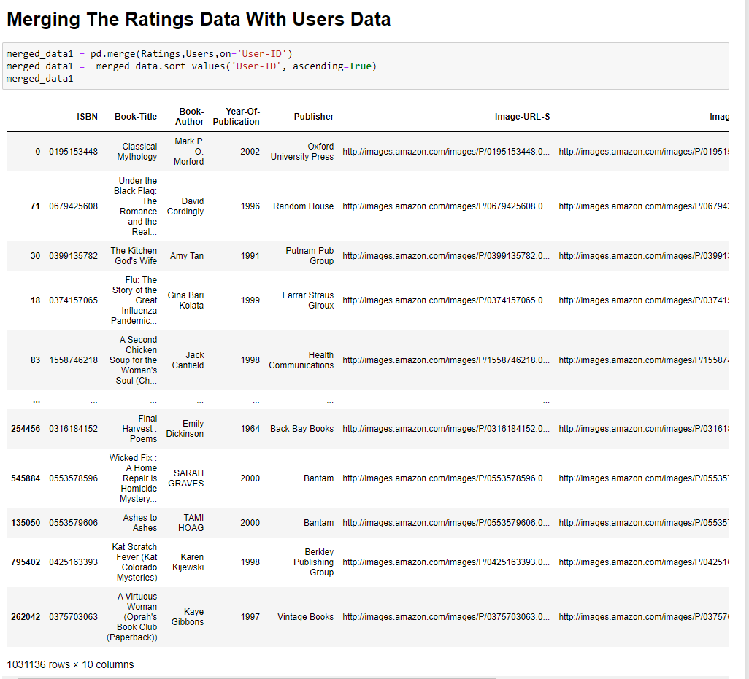
Observations from merge dataset
(USERS and RatingS)

Slide 10
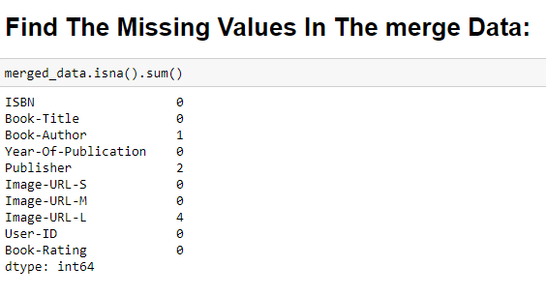
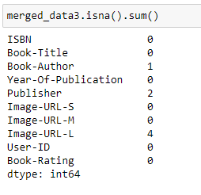
Observations from BOTH merge
dataset (MISSING VALUES)

Slide 11
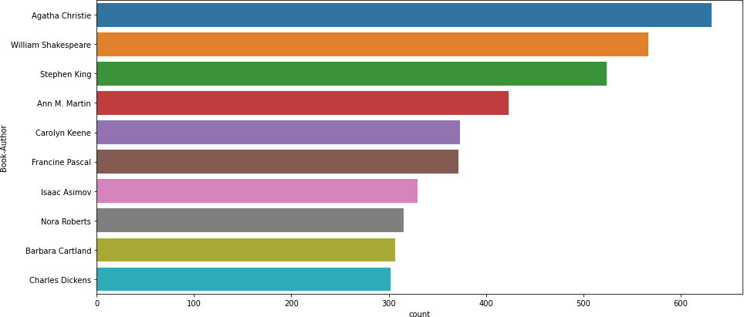
Observations from Books (Authors)
Agatha Christie wrote highest number of books in our given dataset

Slide 12
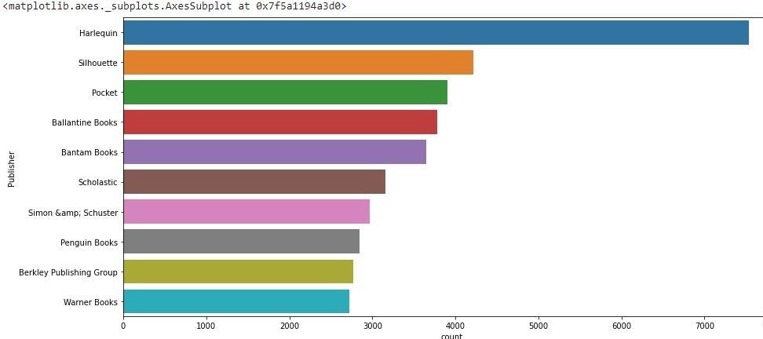
Observations from Books (Publishers)
Harlequin published highest number of books in our given dataset

Slide 13
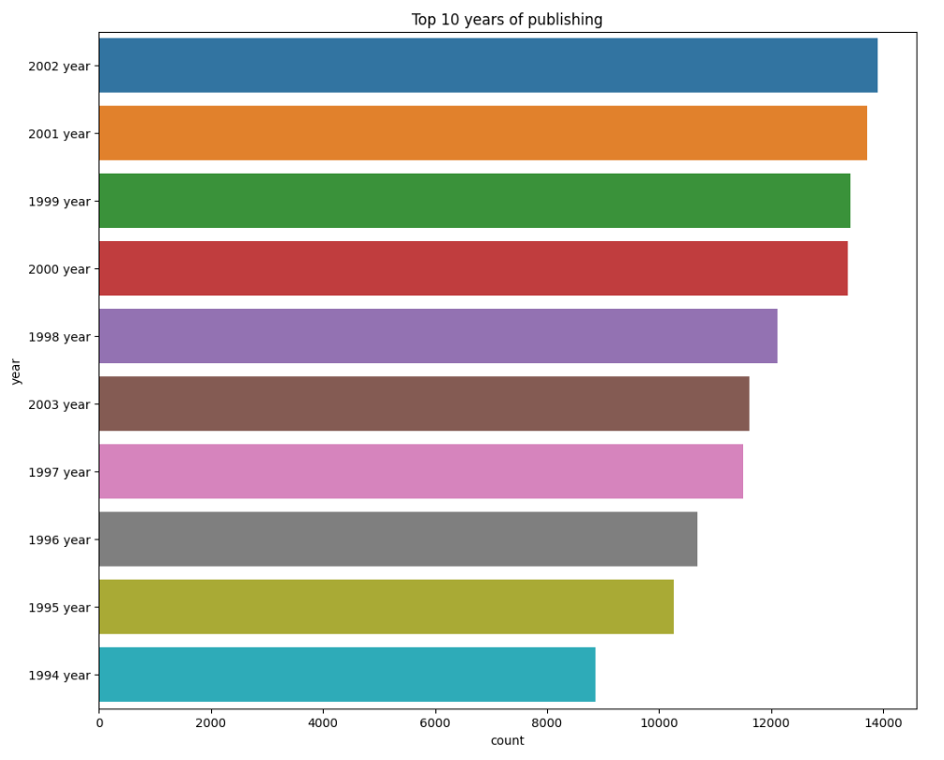
Observations from Books (Publishers)
In 2002 we have highest number of published books in our given dataset

Slide 14
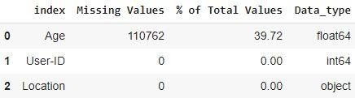
Data Cleaning
1. Null Value Imputation:
Age column has 40% missing values

Slide 15
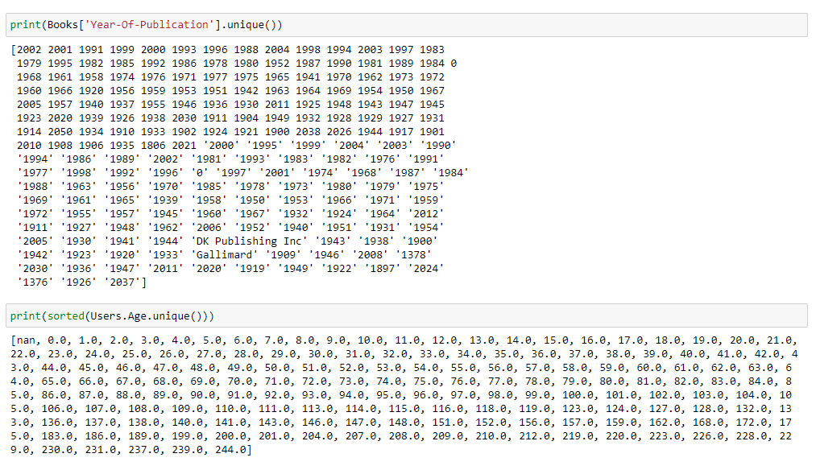
Data Cleaning
1. In year of publication, some years are misleading
2. Age column has 40% missing values and some values are more than 100 which is irrelevant

Slide 16
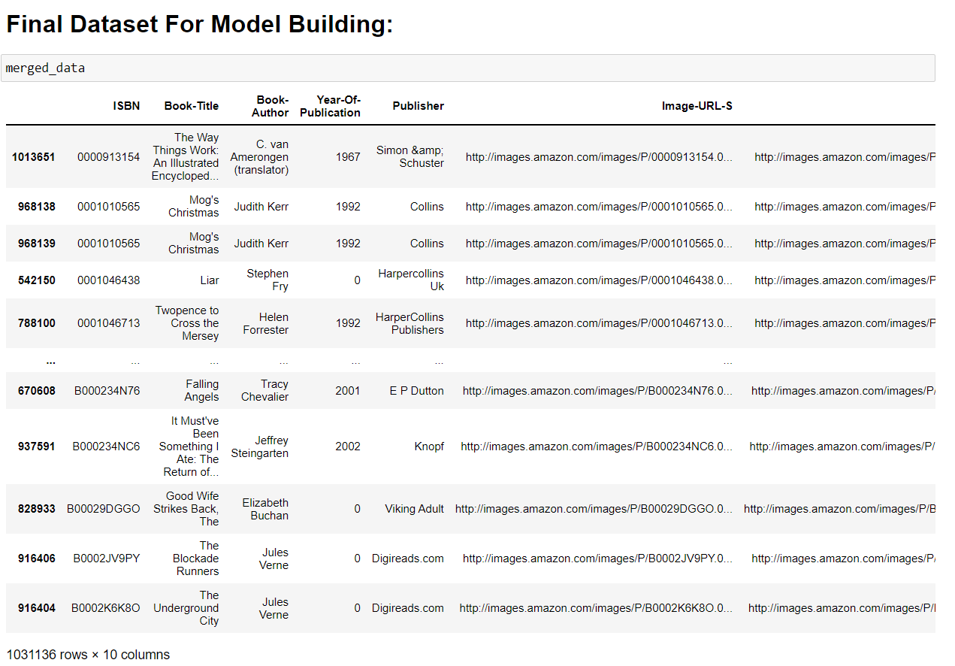
Final Datasets

Slide 17
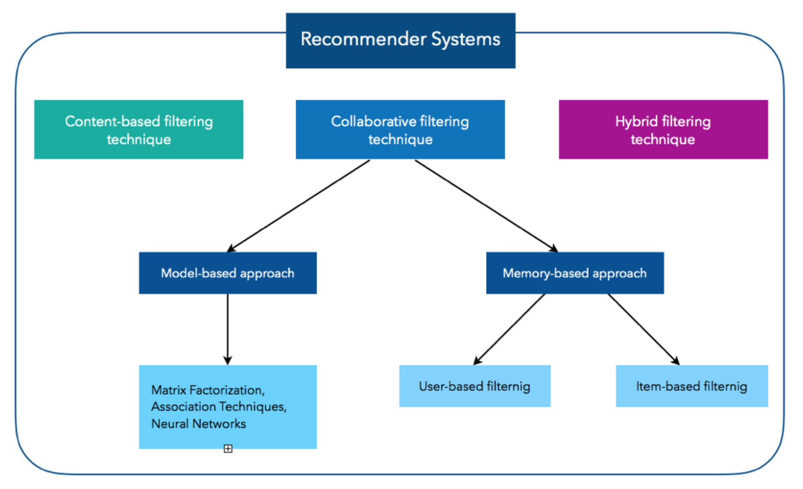
Different Models

Slide 18
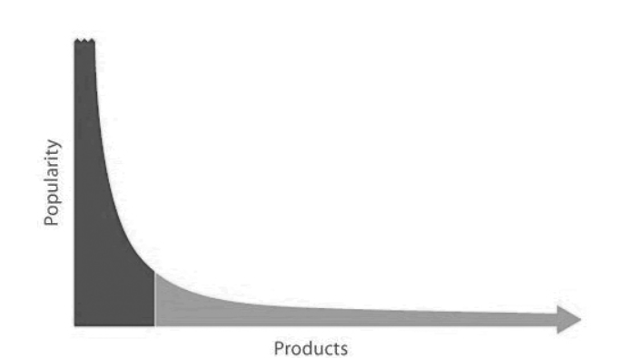
Popularity long tail graph
POPULARITY
Most Popular Books
BOOKS

Slide 19
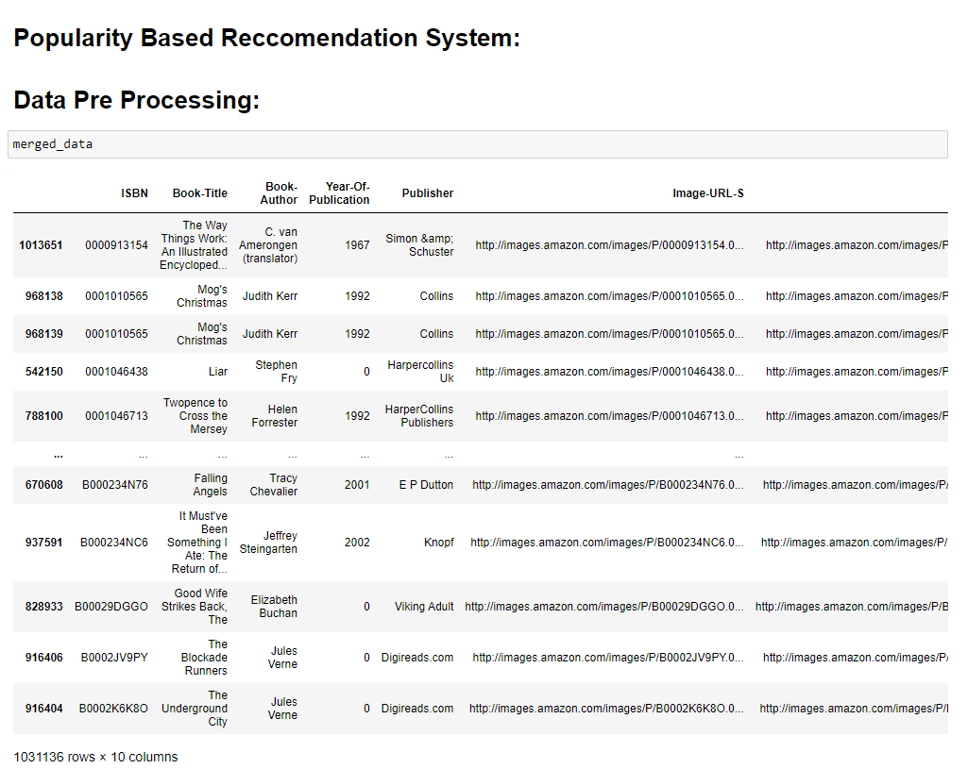

Slide 20
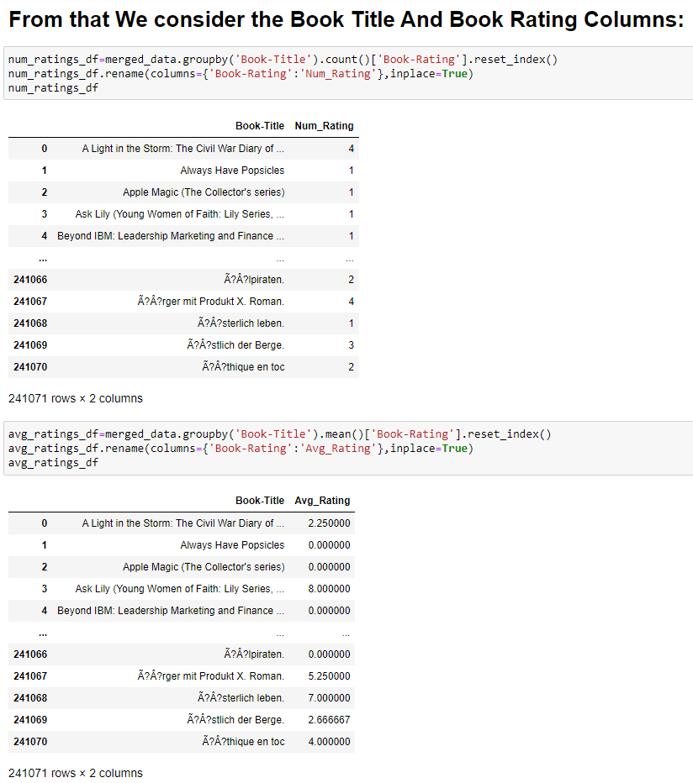
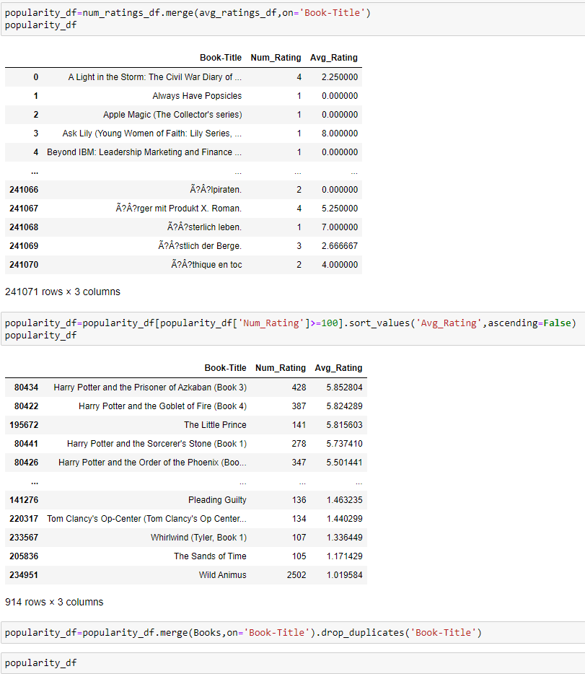

Slide 21
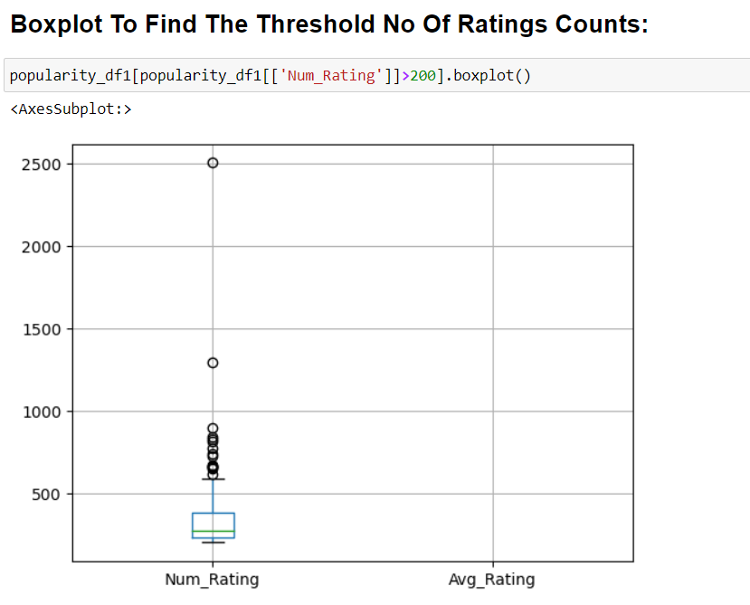
Threshold No. of ratings count

Slide 22
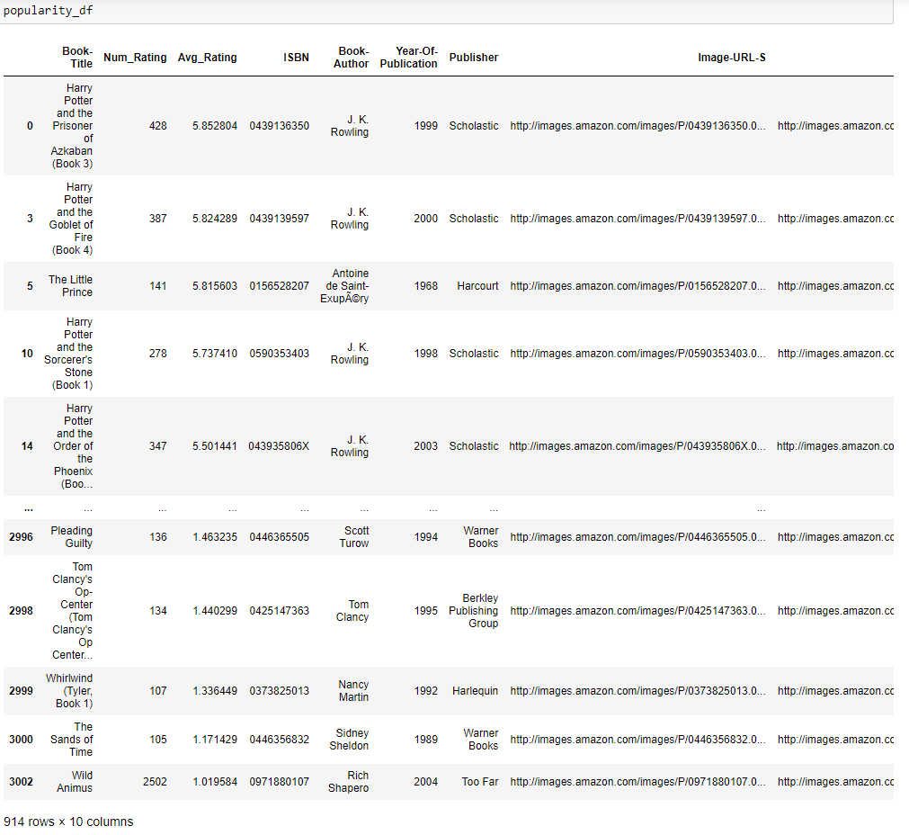
Final representation from
popularity based filtering

Slide 23
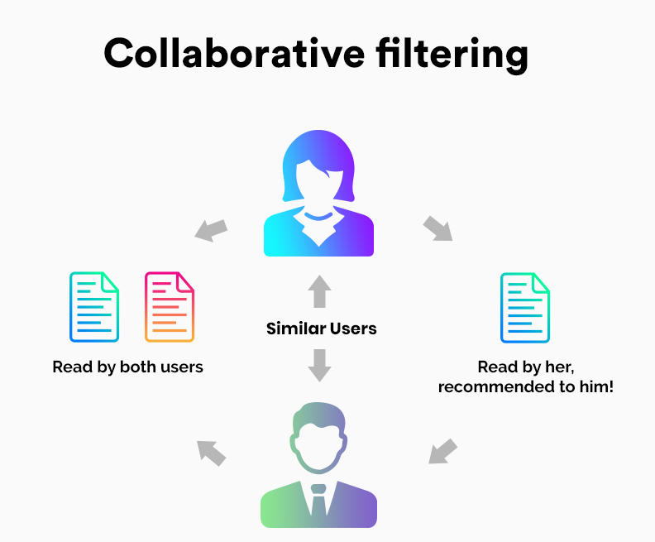

Slide 24
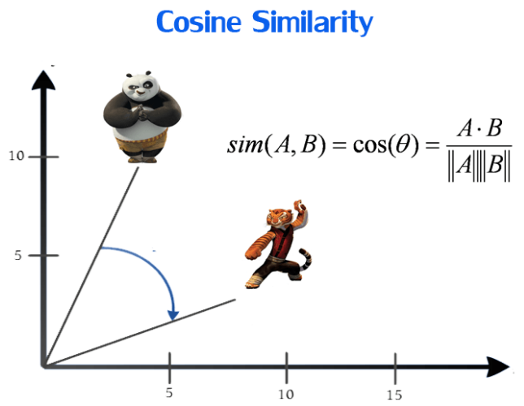
Cosine similarity matrix

Slide 25
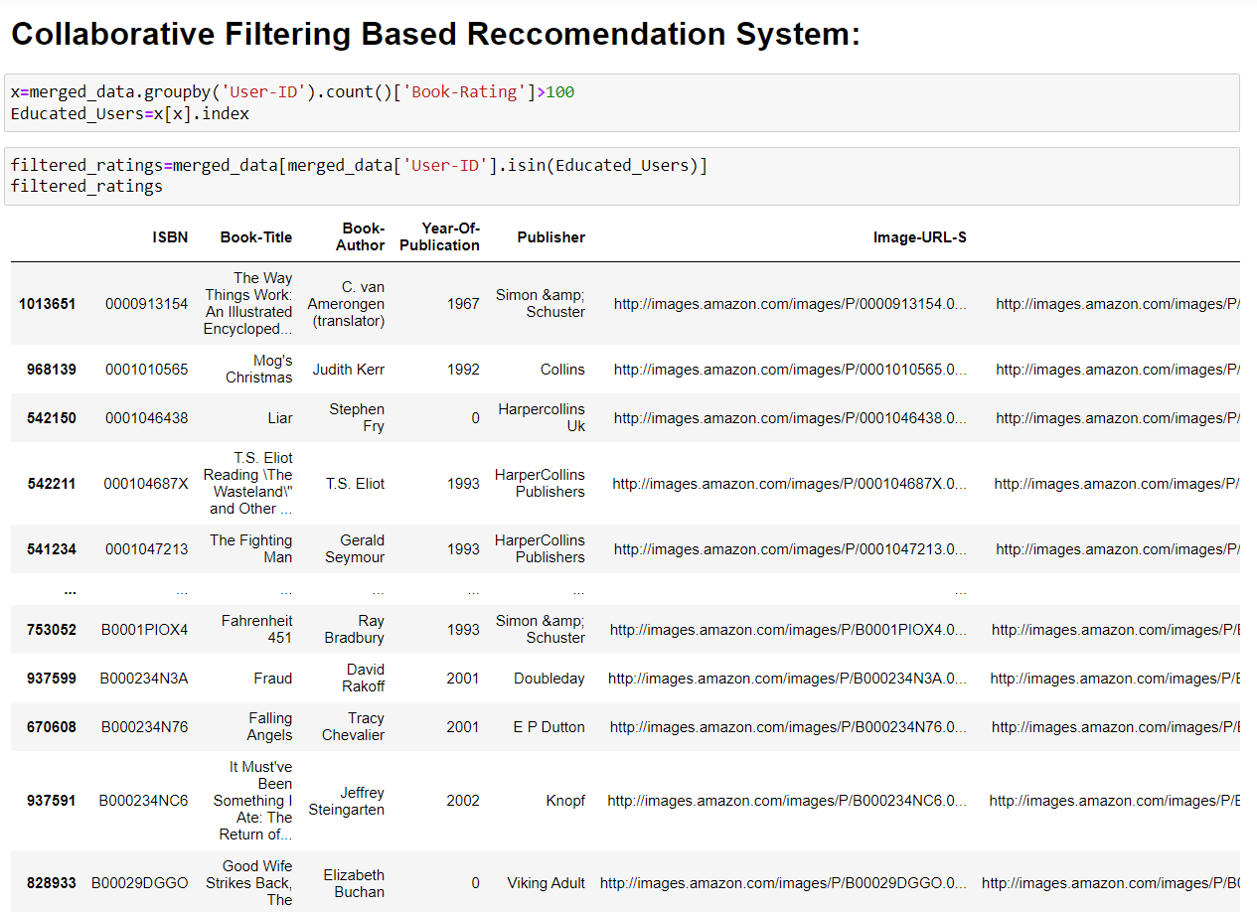

Slide 26
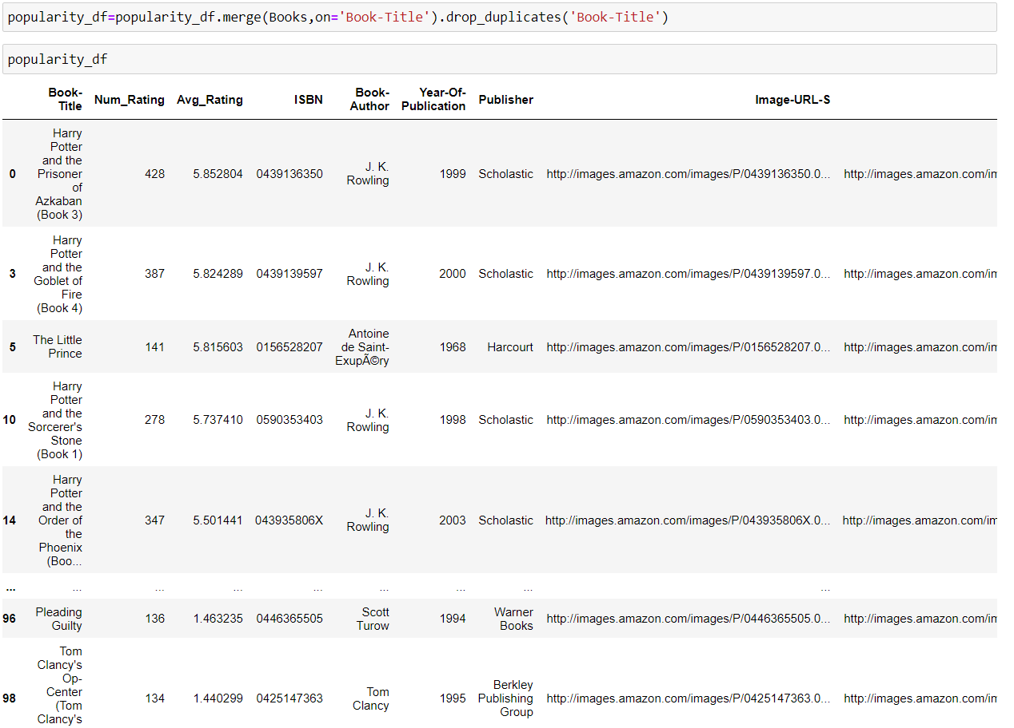

Slide 27
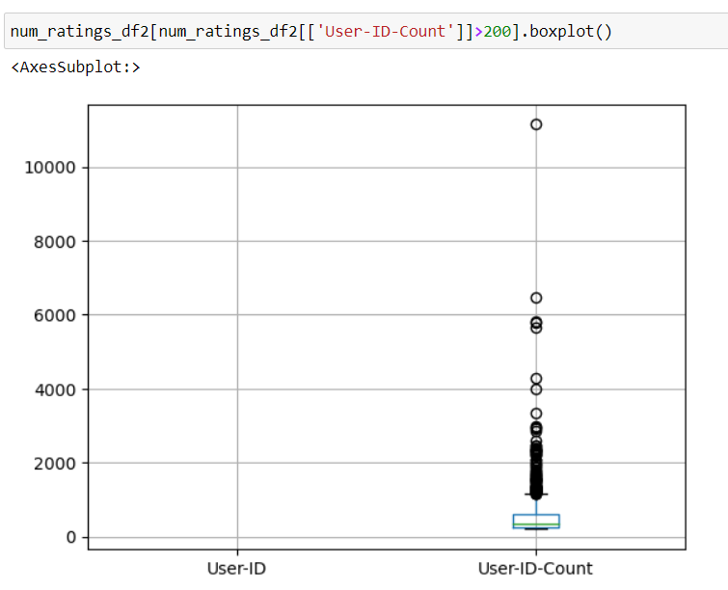
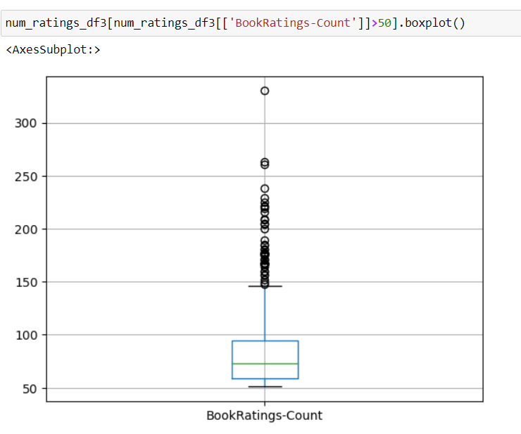
Threshold No. of user_id count with book ratings

Slide 28
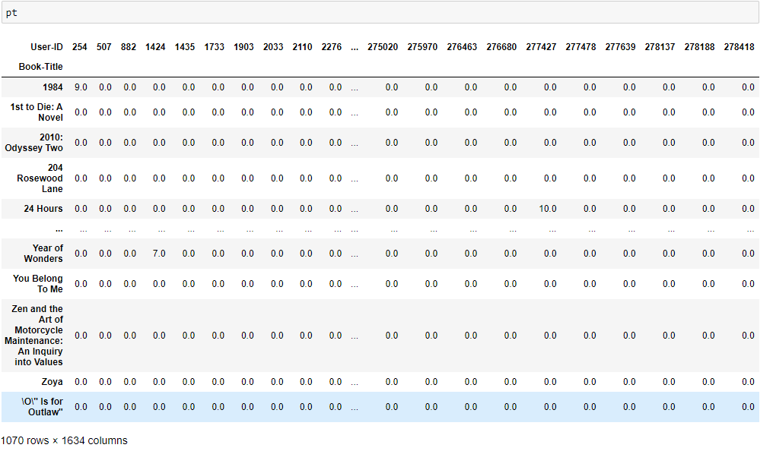
Cosine similarity matrix

Slide 29
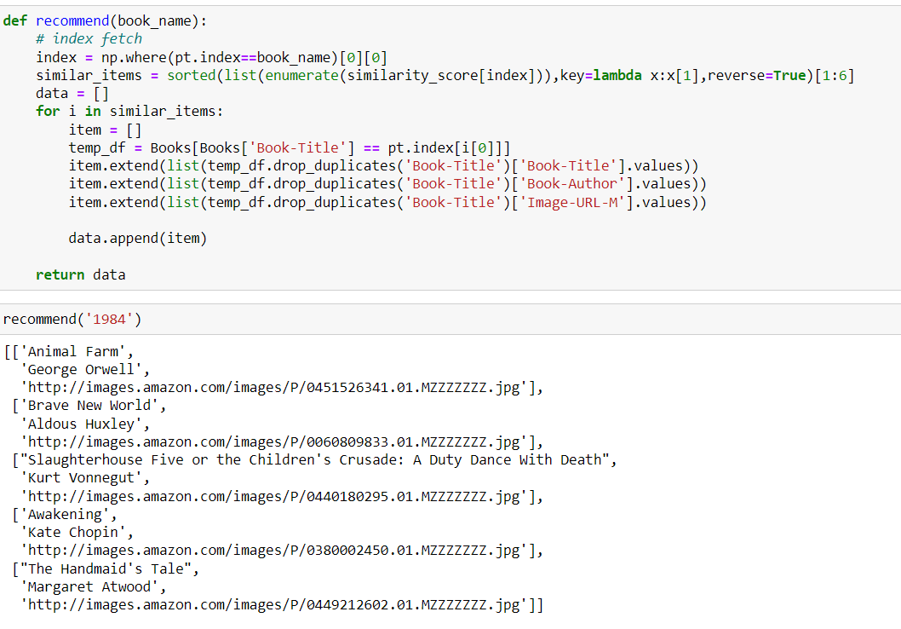
Final representation from
collaborative based filtering

Slide 30
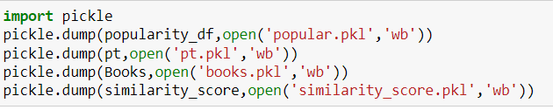
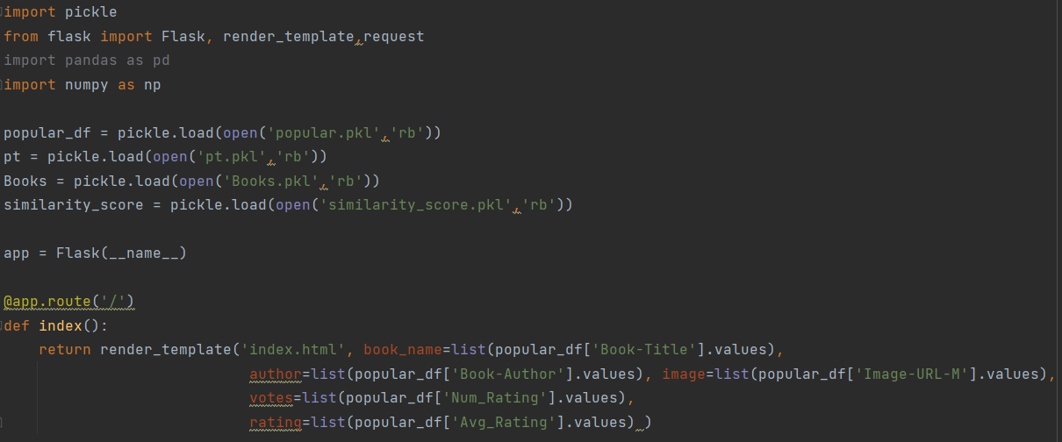
Model Deployment using Flask method

Slide 31
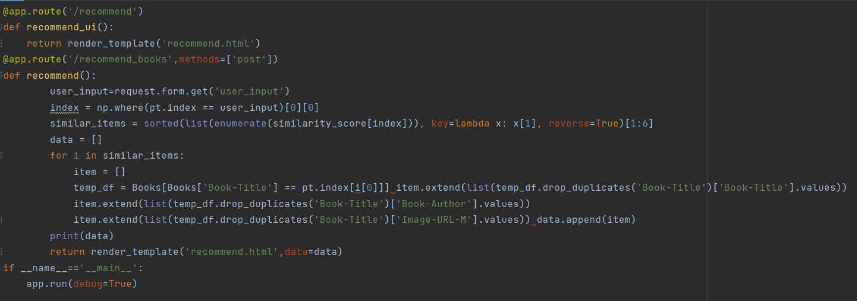
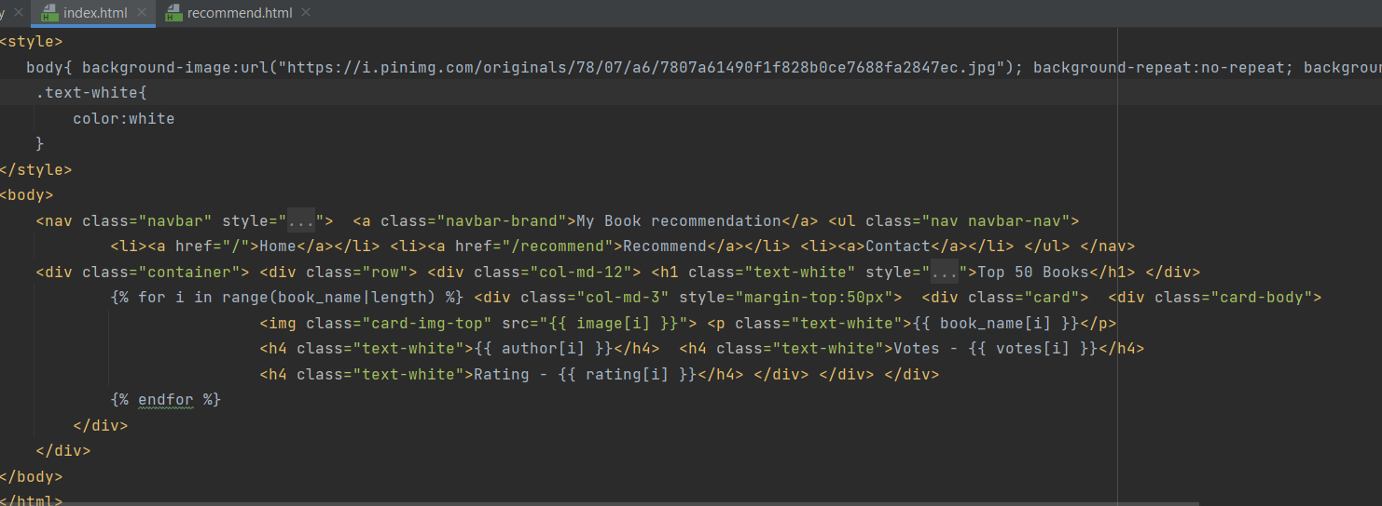
Model Deployment using Flask method

Slide 32

Model Deployment using Flask method

Slide 33

Model Deployment using Flask method

Slide 34
Conclusion
A recommendation system helps an organization to create loyal customers. The recommendation system today are very powerful that they can handle the new customer too who has visited the site for the first time. They recommend the products which are currently trending or highly rated and they can also recommend the products which bring maximum profitto the company.

Slide 35
Challenges
Handling of sparsity was a major challenge as well since the user interactions were not present for the majority of the books.
Understanding the metric for evaluation was a challenge as well.
Since the data consisted of text data, data cleaning was a major challenge in features like Location etc..
Decision making on missing value imputations and outlier treatment was quite challenging as well.

Slide 36
Future Scope
Given more information regarding the books dataset, namely features like Genre, Description etc, we could implement a content-filtering based recommendation system and compare the results with the existing collaborative-filtering based system.
We would like to explore various clustering approaches for clustering the users based on Age, Location etc., and then implement voting algorithms to recommend items to the user depending on the cluster into which it belongs.

Slide 37


